Slide 1
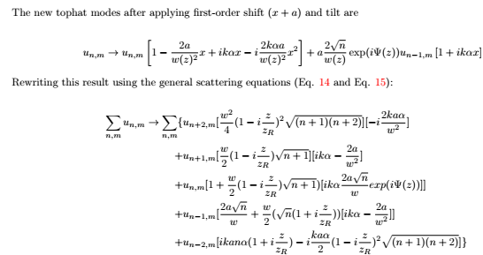
Tophat 1st order shift,tilt METHOD 1
Recovers HG00

Slide 2
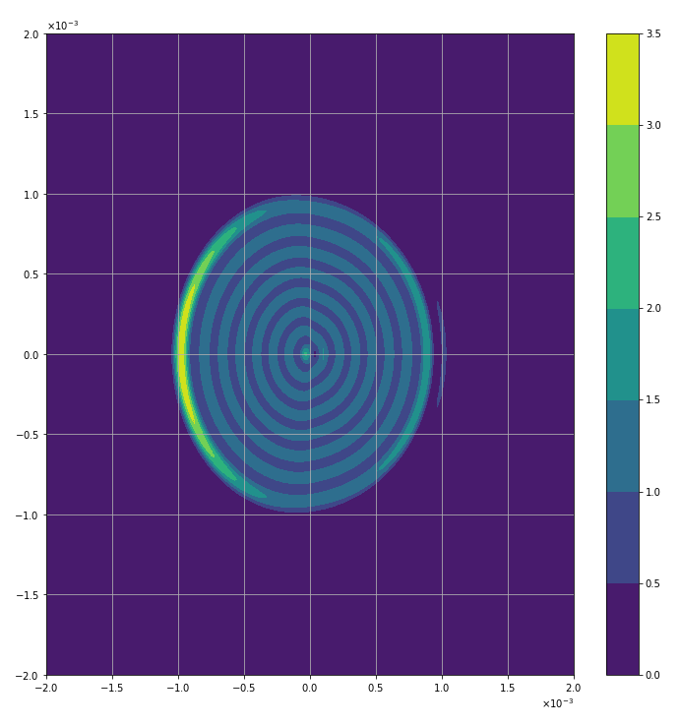
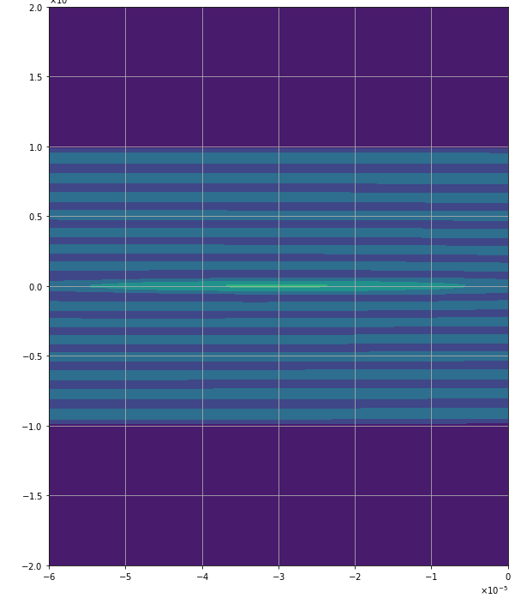
Intensities Tophat, 1st-order shift(shift= 100 micron, tilt=0)
~30 micron

Slide 3
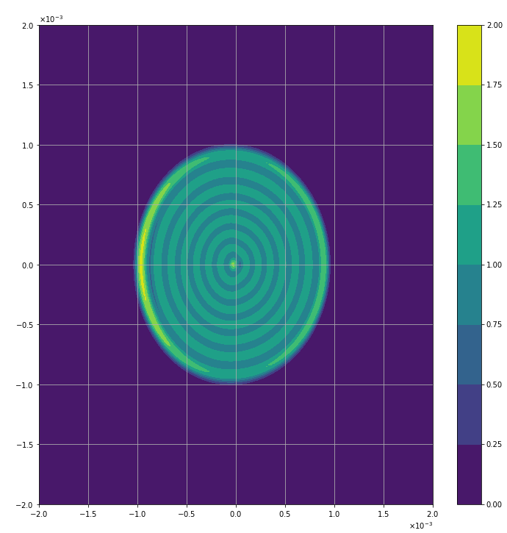
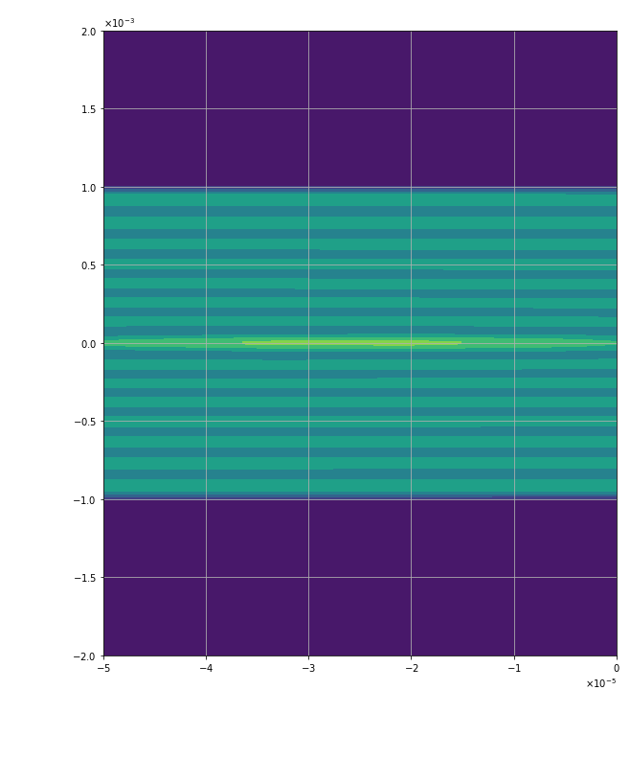
Intensities Tophat, 1st-order shift(shift= 50 micron, tilt=0)
~25 micron

Slide 4
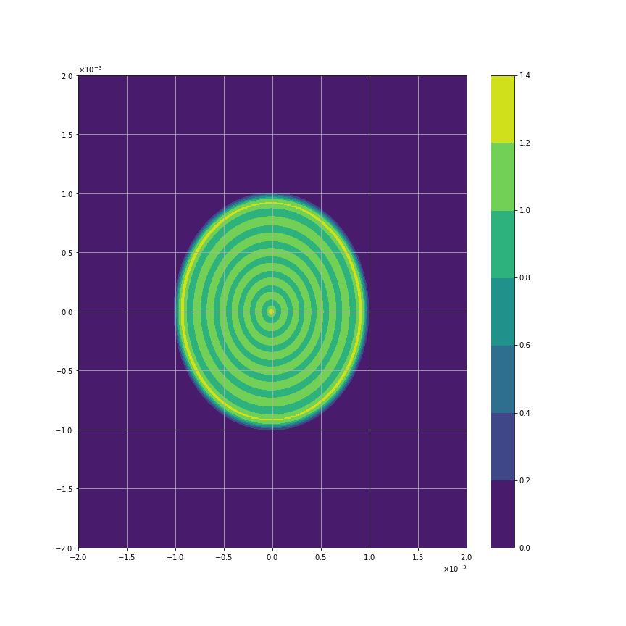
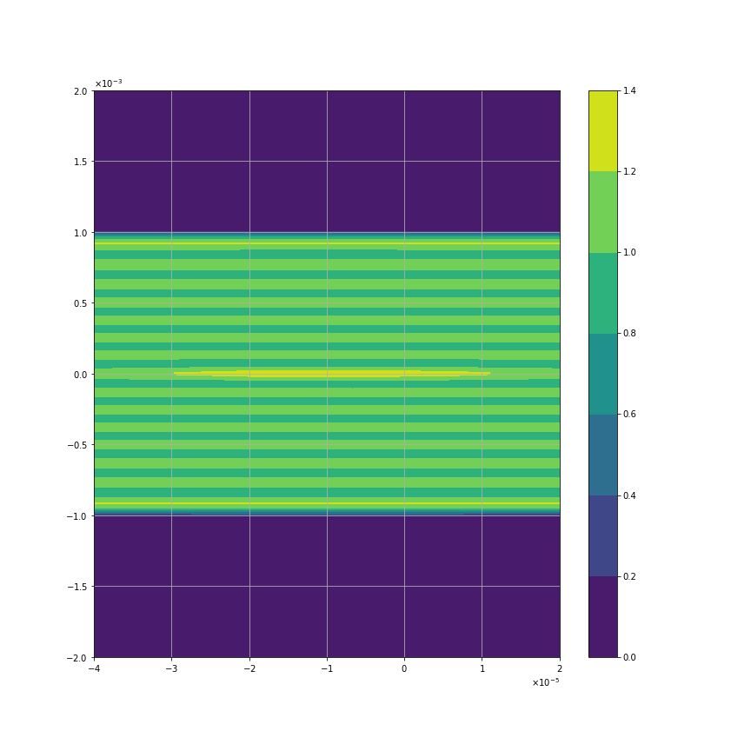
Intensities Tophat, 1st-order shift(shift= 10 micron, tilt=0)
~8 micron

Slide 5
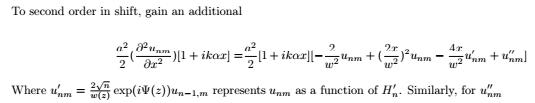
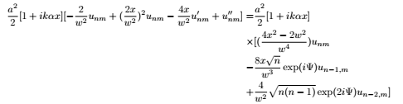
Tophat 2^{nd-}order shift, 1st tilt
Recovers HG00
0 for n,m=0,0
0 for n,m=1,0

Slide 6
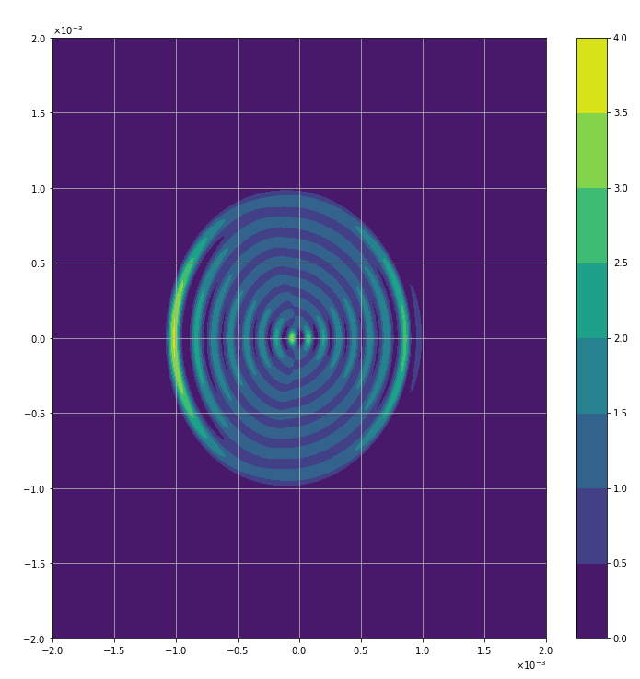
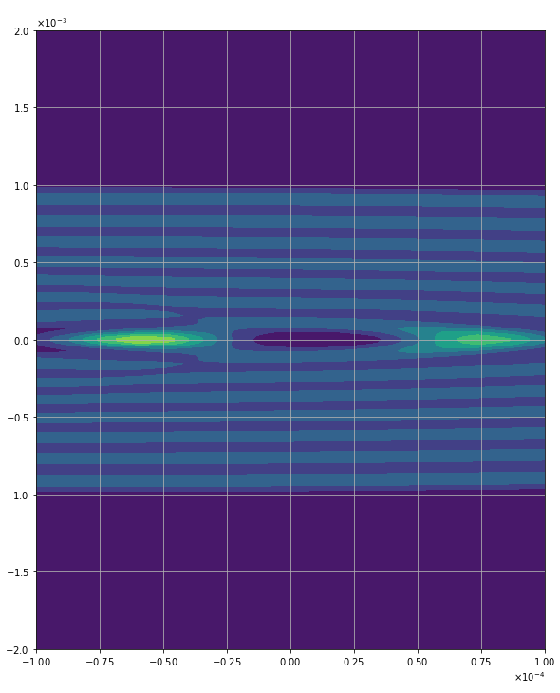
Intensities Tophat, 2nd-order shift(shift=100 micron, tilt=0)
~60 micron

Slide 7

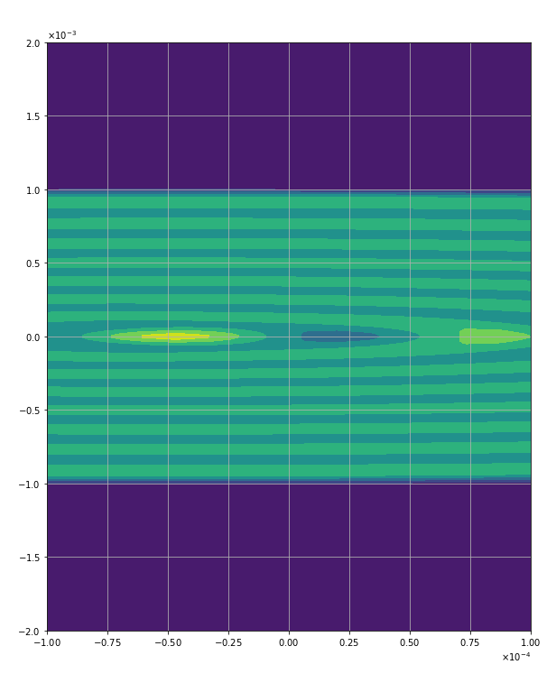
Intensities Tophat, 2nd-order shift(shift= 50 micron, tilt=0)
~47 micron

Slide 8


Intensities Tophat, 2st-order shift(shift= 10 micron, tilt=0)
~10 micron

Slide 9
METHOD 1
METHOD 2

Slide 10
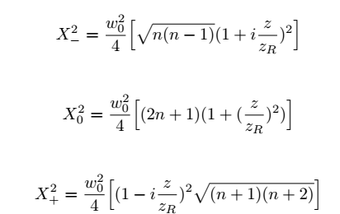
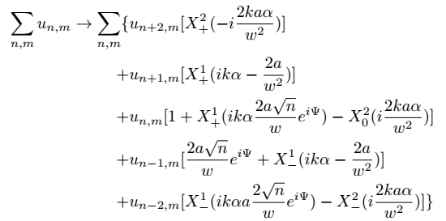
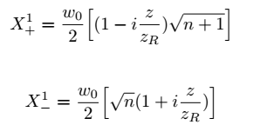
METHOD 2

Slide 11
METHOD 2
Intensities Tophat, 1st-order shift(shift= 10 micron, tilt=0)
~8 micron

Slide 12
METHOD 1
Intensities Tophat, 1st-order shift(shift= 10 micron, tilt=0)
~8 micron

Slide 13
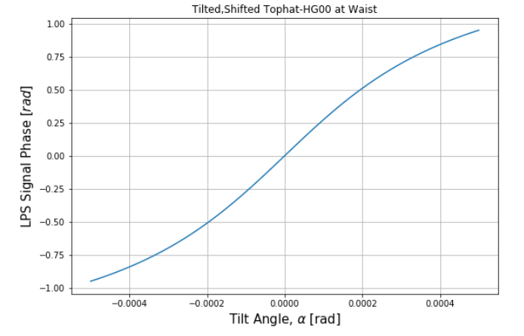
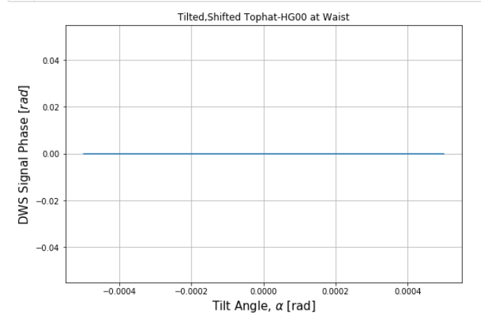
(shift= 10 micron, no gap)

Slide 14
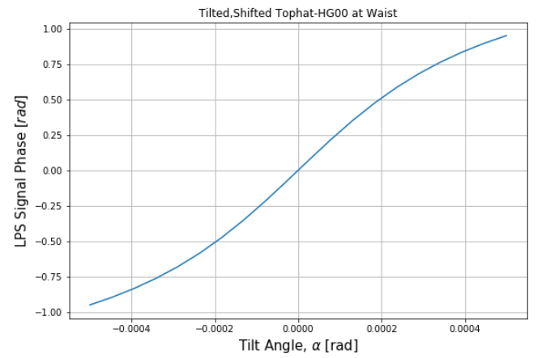
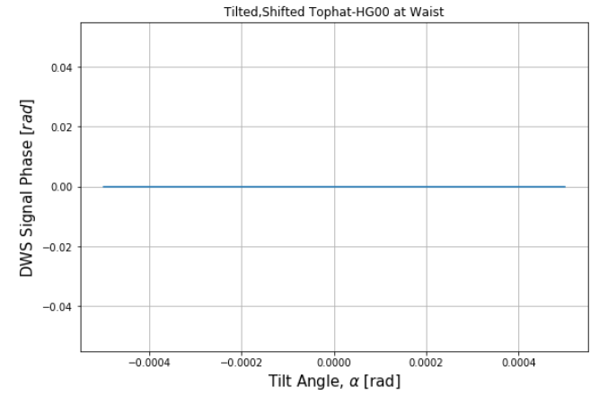
Intensities Tophat, 1st-order shift(shift= 10 micron, gap = .4 mm, 2mm PD)

